Slide 1

Sentinel Behavior & Urbanized American Crows
Alex Popescu
Supervised by Dr. Kiyoko Gotanda
Brock University

Slide 2
What have I been up to? Conferences
Brock's GRaD Conference
OE3C Conference 2023 at Western University
Brock’s MNK Conference
Notes:
MNK – April
OE3C – May
GRaD – September – Received an honorable mention

Slide 3
What else have I been up to?
Brock’s 3 Minute Thesis
Refining my teaching skills by TA-ing various courses
Mentored an undergraduate student
Volunteered at the Ontario Biology Day and the Niagara Regional Science & Engineering Fair
Notes:
3MT – Advanced to the finals at Brock, received excellent feedback

Slide 4
What have I been up to? Community work
SpeedQB
Introduced even more players to a new style of play
Organized several events that attracted players from the Southern Ontario region & from Montreal
I had a great time and received a lot of positive feedback.
I look forward to growing the community even more next year

Slide 5
Chapter 1 - Scoping review
Narrative synthesis completed
Chapter 2 - Field research
Statistical analysis improved & completed
Writing in progress
Writing in progress
What have I been up to?
Thesis
Notes:
Numbers

Slide 6
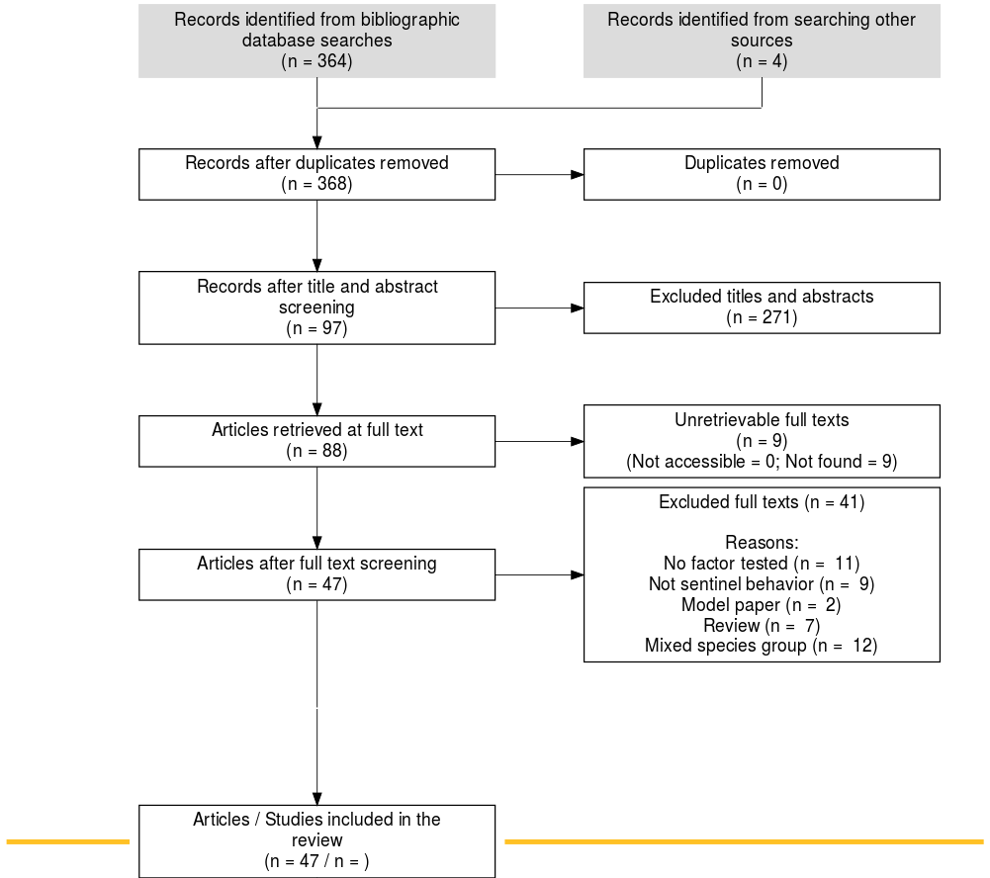
Chapter 1 – The scoping review
Objective: To determine what factors can alter sentinel behavior to infer how urbanization can affect the behavior
Searched 7 databases in Web of Science on Nov. 1st, 2022
Additional articles found using Elicit, an AI-assisted search engine for research articles
Resulted in 47 articles included in my scoping review
All exemplar articles retained
Notes:
Quickly! Don’t spend too much time here.
Important to mention that a true scoping review cannot be unbiased if performed alone. Screening in triplicate to minimize bias.

Slide 7
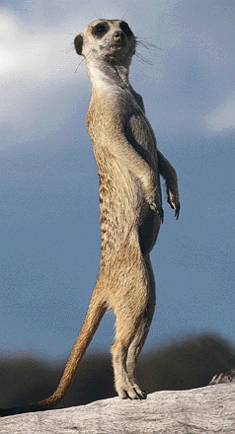
What is sentinel behavior?
Dictionary definition: a soldier or guard whose job is to stand and keep watch
Frequently used definition: an individual that adopts a raised position, scanning for predators and warning others of danger
Notes:
Very frequently observed in avian species, but also found in mammals and even (rabbit)fish
Definition can vary slightly or considerably between articles

Slide 8
A better definition
Frequently used definition: an individual that adopts a raised position, scanning for predators and warning others of danger
Not behaviors exclusive to sentinel behavior
Contributes to the variations in definitions used
Leads to misidentification
More recently, the coordination of sentinel bouts among group members has been identified as the defining feature
Not frequently used in literature
Out of 47 articles retained, 10 mention coordination as defining feature
More difficult to test for
Bednekoff, Peter. (2015). Sentinel Behavior: A Review and Prospectus. Advances in the Study of Behavior. 47. 115-145

Slide 9
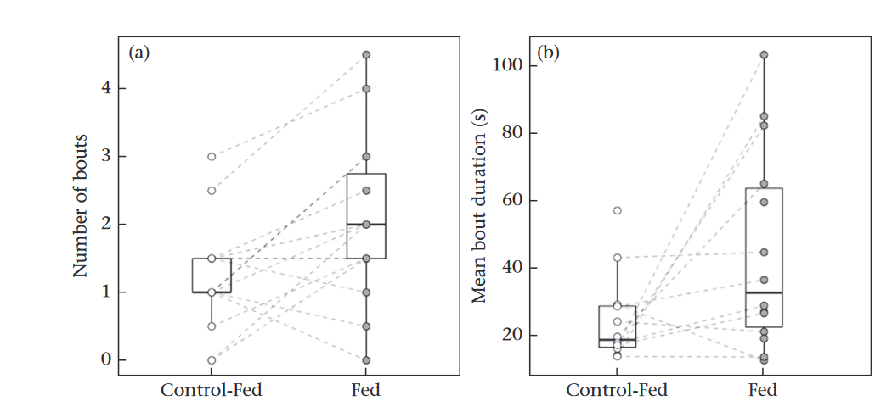
Measurements of sentinel behavior
Generally, some variation on:
Time spent
Bout duration
Number of bouts
From J. J. Arbon et al. (2020) in dwarf mongooses
Yet, many studies use wildly different measurements
Makes performing a meta-analysis difficult to perform
Notes:
For example, some studies use proportion of time or percent overlap or time between bouts.
More nebulous measurements include “sentinel effort”

Slide 10
Main factors identified
Level | Factor | Effect on sentinel “effort” | Species (# Articles)
Individual | Sex: Male | ↑ | Avian (19), S. Mammal (3), L. Mammals (5)
 | Sex x Dominance | Male > Female; Dominant > Subordinate | Avian (6), S. Mammal (1)
 | ↑ Maturity | ↑ | Avian (6), S. Mammal (3), L. Mammal (2)
 | ↑ Body Mass | ↑ | Avian (4), S. Mammal (3), L. Mammal (1)
 | ↑ Satiation | ↑ | Avian (6), S. Mammal (2)
Social | ↑ Group size | Individual ↓, total ↑ | Avian (8), S. Mammal (6), L. Mammal (1)
 | ↑ Dominance | ↑ | Avian (10), S. Mammal (5)
Environmental | ↑ Predation | ↑ | Avian (6), S. Mammal (5), L. Mammal (2)
 | ↑ Anthro. Disturb | ↑ | Avian (4), S. Mammal (1), L. Mammal (1)
Other factors include breeding period, time of day, presence of young (pups), other sentinels/sentinel effort of other group members, presence/contact with rival or outgroup conspecifics…

Slide 11
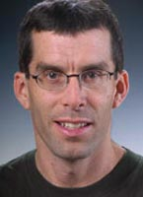
Selfish sentinels
What if there was a better explanation for sentinel decision-making?
Proposed by Dr. P.A. Bednekoff in 1997, the selfish, state-dependent model for sentinel decision-making best explains sentinel decision-making
Relies on three main assumptions:
Sentinel behavior is a low-cost activity performed by individuals that have sufficient energetic reserves from foraging.
Benefits of sentinel behavior arise only from an increase in personal safety, not from protecting other group members
Safe refuges do not exist, therefore the sentinel's post is the safest place to be if the alternative is foraging without a sentinel
Bednekoff, P.A., Mutualism among Safe, Selfish Sentinels: A Dynamic Game. The American Naturalist 1997 150:3, 373-392

Slide 12
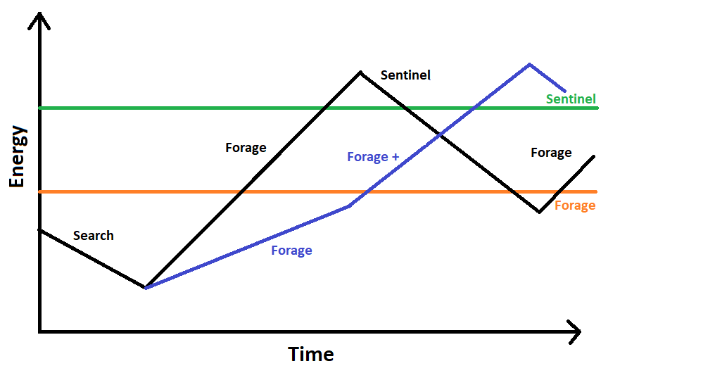
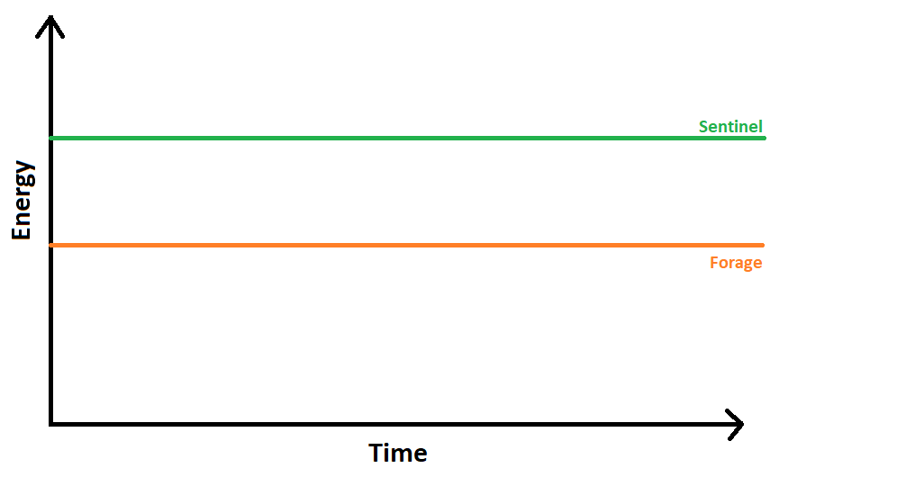
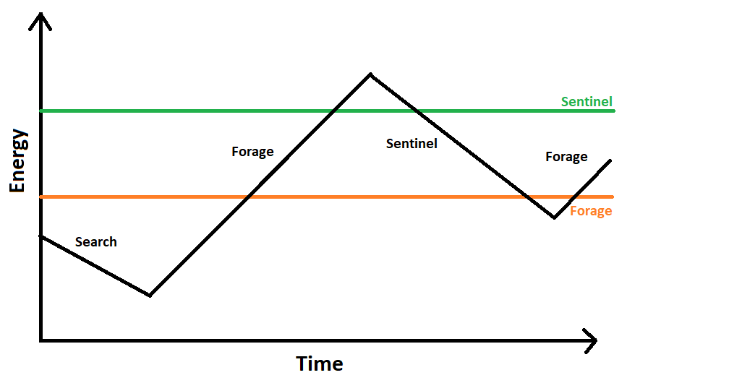
In other words?
DANGER ZONE

Slide 13
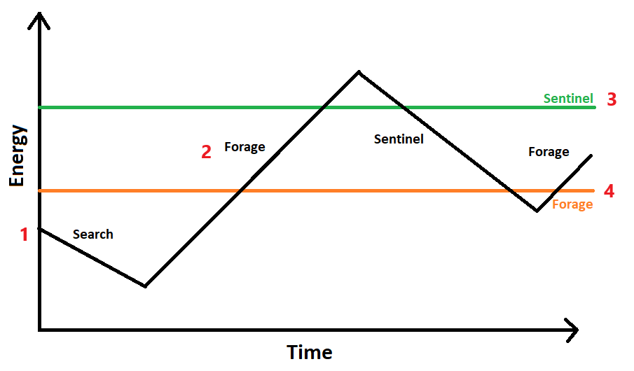
Main factors identified
Level | Factor | Point
Individual | Sex: Male | 3, 4
 | Sex x Dominance | 1, 2, 3, 4
 | ↑ Maturity | 2
 | ↑ Body Mass | 1
 | ↑ Satiation | 1
Social | ↑ Group size | -
 | ↑ Dominance | 1, 2
Environmental | ↑ Predation | 3
 | ↑ Anthro. Disturb | 3

Slide 14
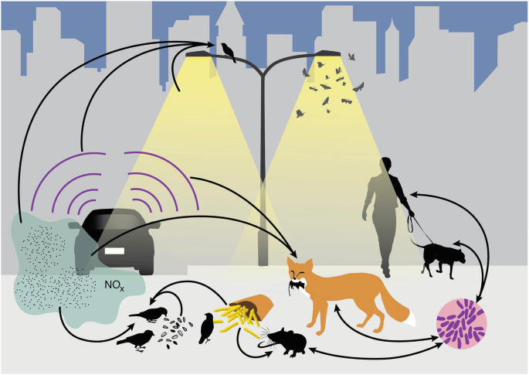
Effects of urbanization
We have modified the environment to suit our needs…
More impermeable surfaces
Infrastructure
Presence of trash cans, litter
And we inevitably have an impact on wildlife
Increased proximity and interactions with humans
People feeding animals
Anthropogenic noise & disturbances
Isaksson, C. (2018). Impact of Urbanization on Birds. In: Tietze, D. (eds) Bird Species

Slide 15
Effects of urbanization
Factor | Point
↑ Impermeable surface area | 2, 3
↑ Predictability of food sources | 1, 2, 5
↑ Availability of food sources | 1, 2, 5
↑ Infrastructure | -
↑ Anthropogenic noise | 4, 5
Heat island effect | 1
↑ Proximity to humans & pets | 5, 6
5
4
1
3
6
2
This is by no means an exhaustive list

Slide 16
Sentinels and urban settings
Urban settings are expected to increase the likelihood of sentinel behavior
Increased access to food = ↑ Energy
Presence of urbanized predators and humans = ↑ Risk
Abundant locations for sentinels to perch on
In turn, sentinels are expected to decrease the individual vigilance of foragers.

Slide 17
Chapter 2 – The empirical study
Objective: To determine whether and how individual vigilance while foraging is affected by the presence of a sentinel and the environment in which the individual forages in.
The modified use of social behaviors in urbanized species is understudied and could explain, in part, the success of American crows in urban areas
Prediction: Foragers would be less vigilant in the presence of a sentinel but be more vigilant in commercial areas.

Slide 18
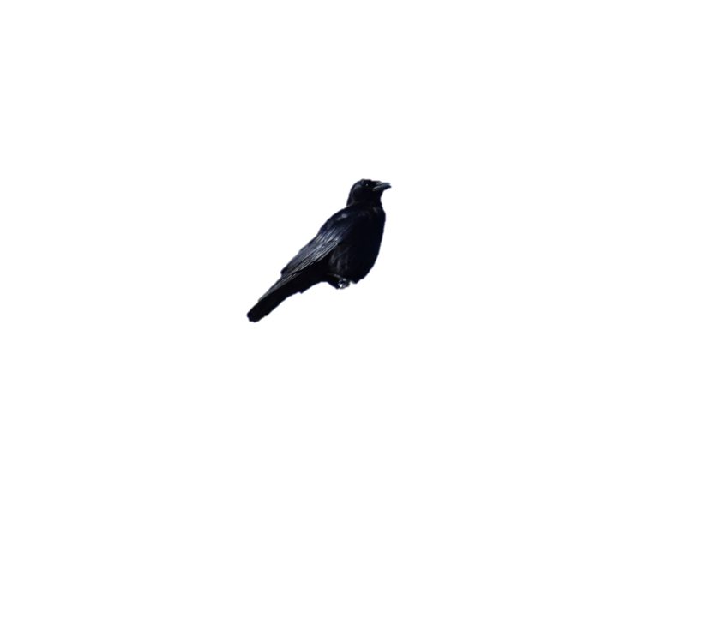
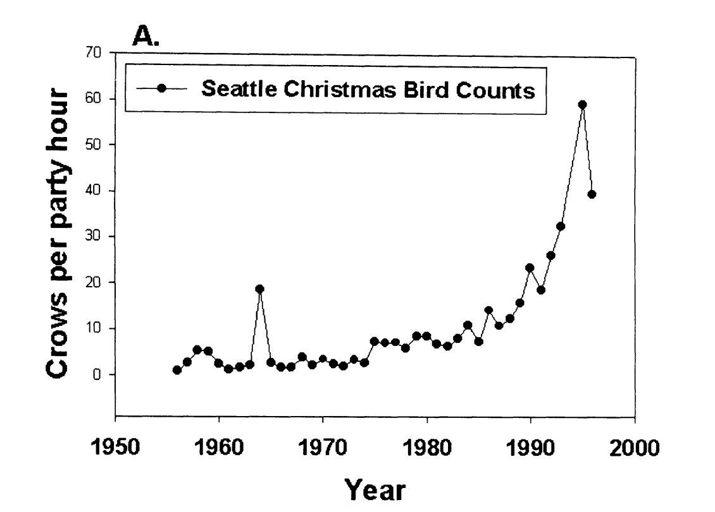
American crows in urban areas
Does the social nature of urbanized species contribute to their success in urban areas?
Crows spotted per hour
American crows (Corvus brachyrhynchos) are an ideal model to test for social behaviors in urbanized species.
Marzluff et al.(2001). Avian Ecology and Conservation in an Urbanizing World || Causes and consequences of expanding American Crow populations.
Notes:
We picked the crow bc… Talk about G. env

Slide 19
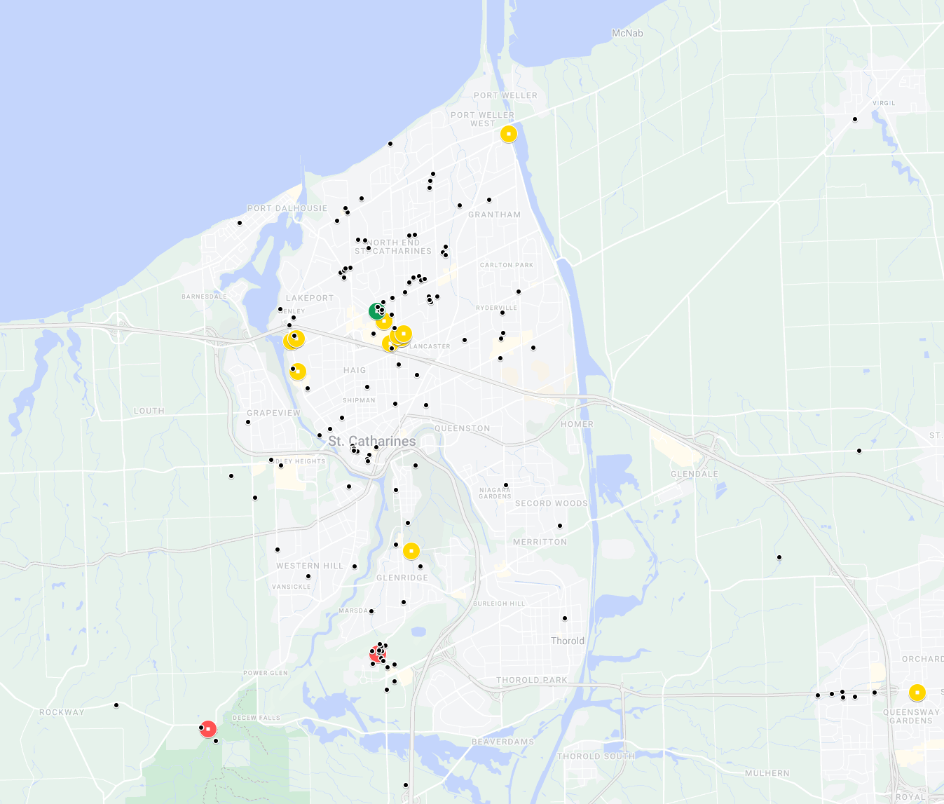
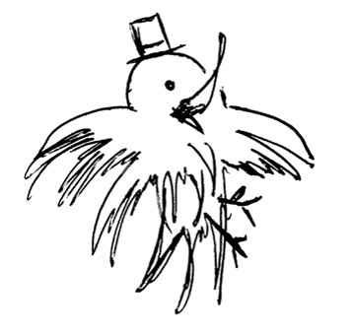
Crowkemon Go
Started in Jan 2022
Participants across the Niagara region were invited to mark the locations of crows.

Slide 20
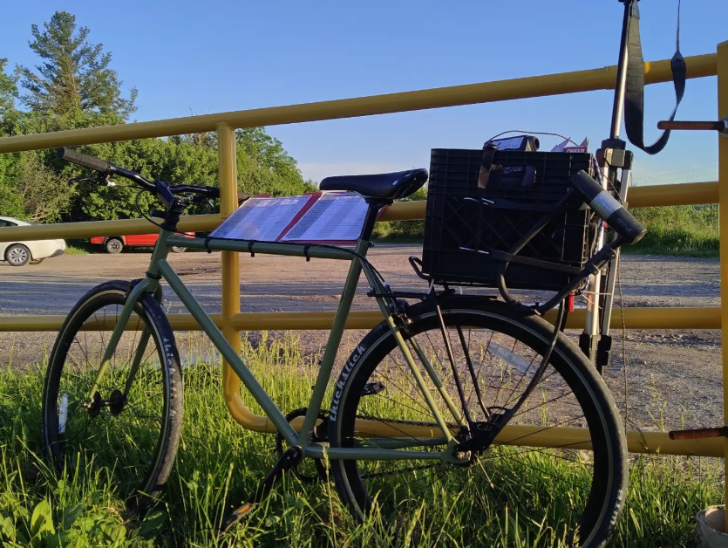
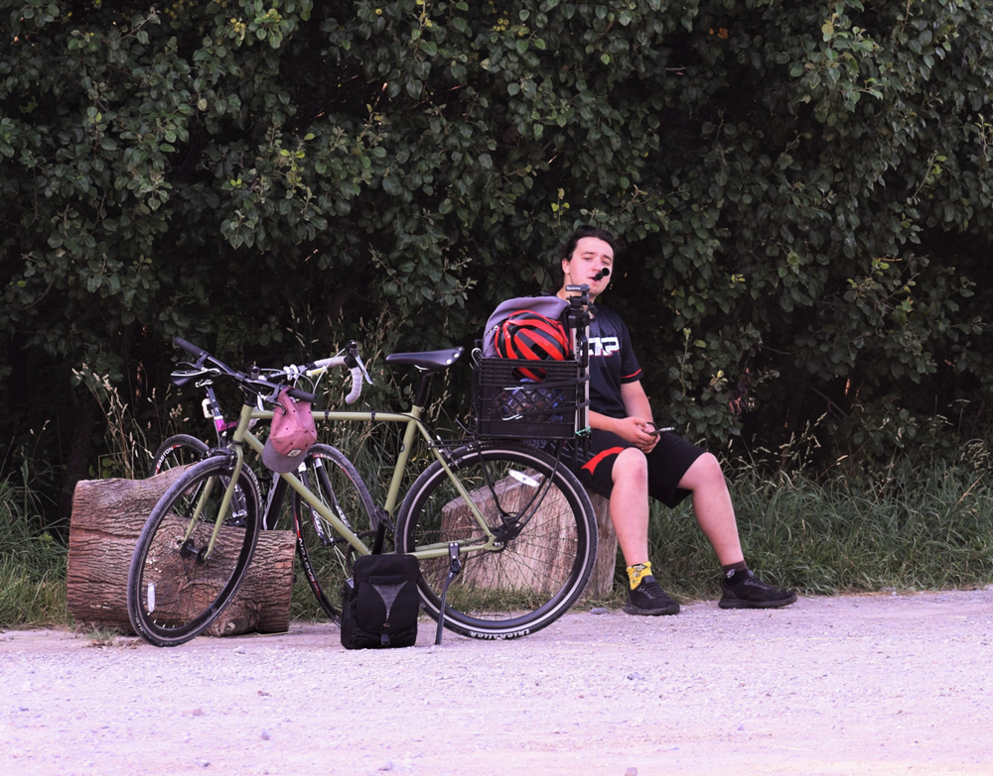
Methods
Foraging bouts were video recorded from a distance and coded at a later date
25 videos recorded from May to September 2022
Notes:
Armed with friends, cameras and bicycles, we bravely went out at 6am to chase crows!
Remove bait

Slide 21



Methods - Ethogram
Behavior | Vigilance | Definition | Illustration
Foraging | ↓ | Focal individual is stationary and has its head downwards or in a non-upright position, either pecking or handling food, looking for food, or engaging in other behaviors that make vigilance ineffective (e.g. preening).
Moving |  | Focal individual is moving, either by flying, hopping (leaping), or walking.
Alert | ↑ | The focal individual is stationary and has its head and body in an upright position. Individuals can have a mobile (scanning) or immobile head but must not be looking downwards. Individuals can be handling food.
All illustrations are under creative commons license (copyright-free)
Notes:
Much simpler ethogram

Slide 22
Methods – Measurements & Statistical Analysis
Measurements | Test performed | Predictions
 |  | Sentinel Presence | Commercial Area
Likelihood of a sentinel being present | Chi-Squared |  | ↑
Allocation of time | Linear Model | Alert ↓ Foraging ↑ | Foraging ↓ Alert ↑
Duration of behavioral instances | (Robust) Linear Mixed Model | Alert ↓ Foraging ↑ | Foraging ↓ Alert ↑
Peck Rate | (Robust) Linear Mixed Model | Peck rate ↑ | Peck rate ↑
Number of transitions | Generalized Linear Mixed Model (Poisson) | Foraging → Alert ↓ Alert → Foraging ↑ | Foraging → Alert ↑ Alert → Foraging ↓
Notes:
Much simpler ethogram

Slide 23
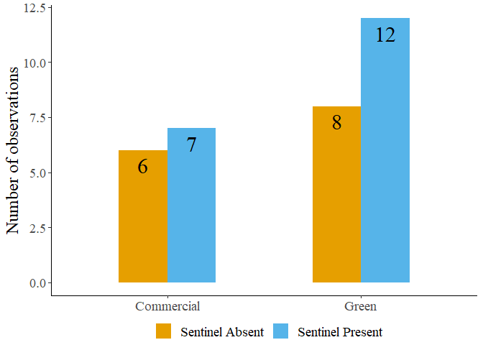
Results: Likelihood of sentinel presence
Chi-square tests revealed no effects of generalized environment, disturbance frequency or group size.

Slide 24
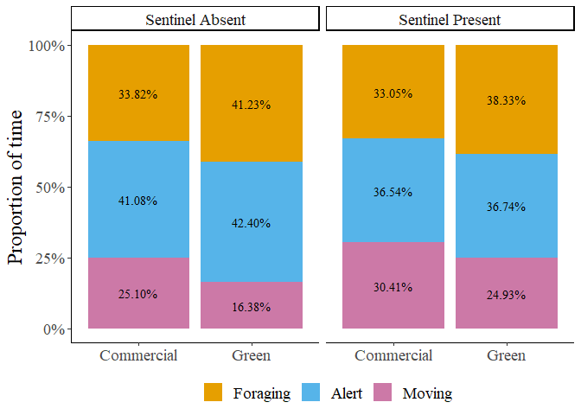
Results: Allocation of time
Linear model fit to proportion of time revealed no effects of sentinel presence or generalized environment
Proportion of time allocated to each behavior by foragers in commercial and green areas

Slide 25
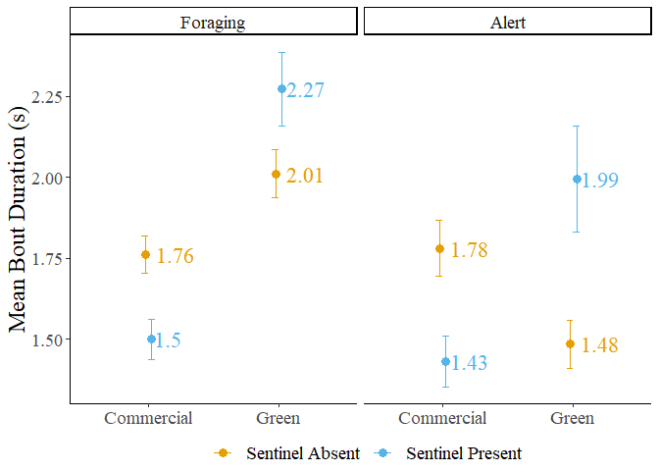
Results: Bout Duration
Sentinel presence significantly increased the duration of all bouts.
Bouts of foraging behavior were significantly shorter in commercial areas.
Mean bout duration of foragers in commercial and green areas
The dots represent the mean value, and the error bars represent the standard error.

Slide 26
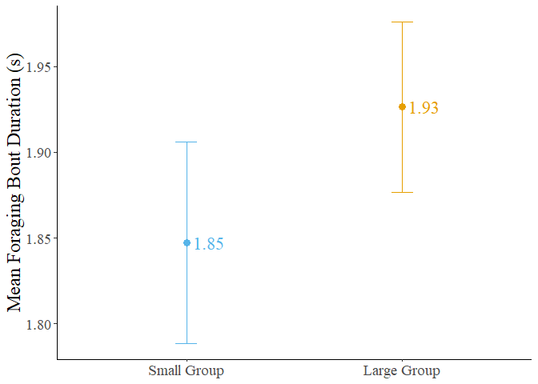
Results: Bout Duration
Bouts of foraging behavior were significantly longer in large groups.
Mean foraging bout duration of crows foraging in small and large groups
The dots represent the mean value, and the error bars represent the standard error.

Slide 27
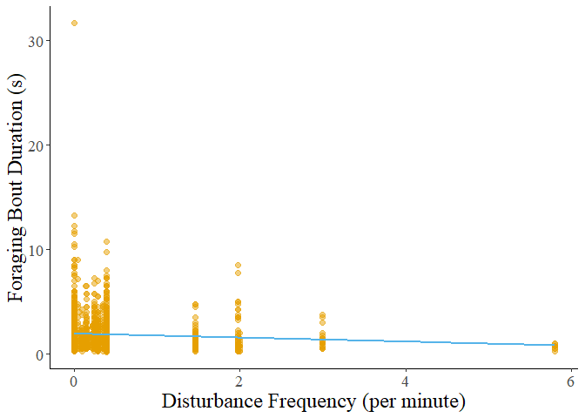
Results: Bout Duration
Bouts of foraging behavior significantly decreased as disturbance frequency increased.
Foraging bout duration decreasing with increasing disturbance frequency

Slide 28
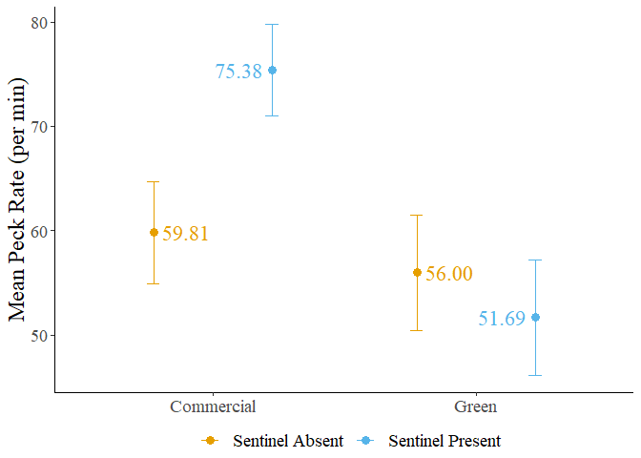
Results: Peck Rate
Neither sentinel presence nor generalized environment had a significant effect on forager peck rate.
Mean peck rate of foragers in commercial and green areas
The dots represent the mean value, and the error bars represent the standard error.

Slide 29
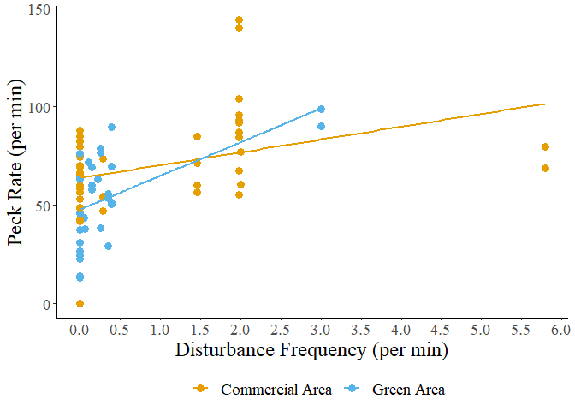
Results: Peck Rate
Peck rate significantly increased as disturbance frequency increased.
Peck rate increasing with increasing disturbance frequency

Slide 30
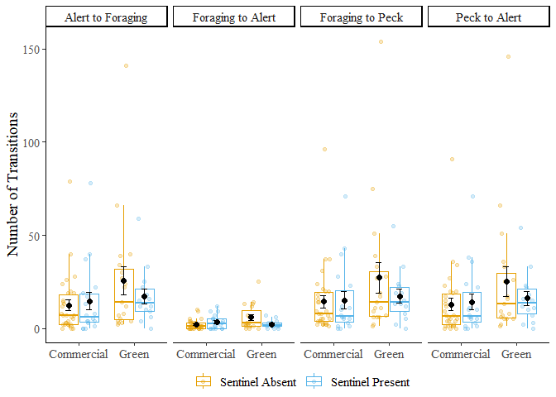
Results: Number of transitions
There were significantly fewer transitions from foraging to alert behavior in commercial areas.
Number of transitions performed by foragers in commercial and green areas
The black dots represent the mean value, and the error bars represent the standard error.

Slide 31
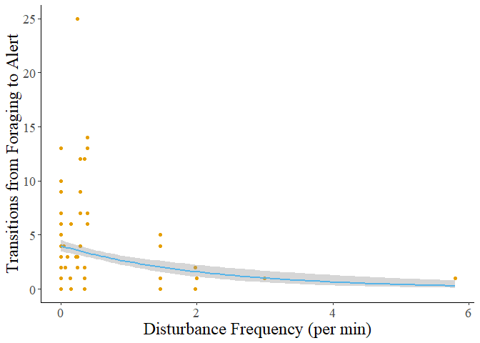
Results: Number of transitions
The number of transitions from foraging to alert behavior significantly decreased with increasing disturbance frequency
Transitions from foraging to alert behavior increases as disturbance frequency increases
The grey shadow represents the standard error of the curve.

Slide 32
Conclusions
Measurements | Predictions |  | Other effects
 | Sentinel Presence | Commercial Area
Likelihood of a sentinel being present |  | ↑
Allocation of time to behaviors in foragers | Alert ↓ Foraging ↑ | Foraging ↓ Alert ↑
Duration of behavioral instances | Alert ↓ Foraging ↑ | Foraging ↓ Alert ↑
Peck Rate | Peck rate ↑ | Peck rate ↑
Number of transitions | Foraging → Alert ↓ Alert → Foraging ↑ | Foraging → Alert ↑ Alert → Foraging ↓
No Effect
No Effect
All bouts ↑
Foraging ↓
Disturbance Freq.
Group size
No Effect
Disturbance Freq.
No Effect
Foraging → Alert ↓
Disturbance Freq.
Notes:
Much simpler ethogram

Slide 33
My conclusions
While urbanization could affect the likelihood of sentinel presence, my sample size is too small to make any firm conclusions.
The presence of a sentinel increased the duration of bouts of all behaviors but did not significantly change how much time an individual allocates to either vigilance or foraging behaviors.
Commercial areas significantly decreased the duration of foraging bouts and decreased the number of transitions from foraging to alert behavior, yet it did not affect the duration of bouts of alert behavior.
Foragers appear to be more responsive to disturbance frequency than their foraging environment.

Slide 34
Future Endeavors
Finish writing my thesis & successfully defend it
Upon completion, improve chapters & publish two articles
Continue improving my abilities as a teaching assistant
Network with fellow researchers & find future career opportunities

Slide 35
Timeline
Thesis draft completed by mid-December
Final draft completed & sent to you in early 2024
Thesis defense by the end of the Winter 2024 semester

Slide 36
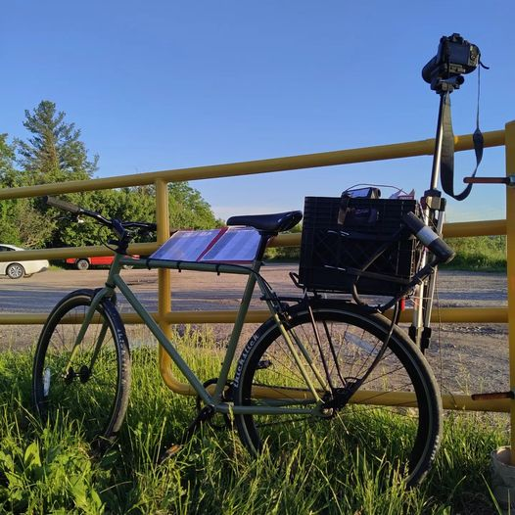
I greatly appreciate your feedback and constructive criticism

